Slide 1


Angular
Aruna S
Department of
Computer Science and Engineering

Slide 2

ANGULAR
Angular CLI and Test App
S. Aruna
Department of Computer Science and Engineering

Slide 3
Angular
Angular Frameworks – Prerequisites and Basics
Typescript
CLI project folder structure
the config JSON files
ng serve vs ng build
Angular the binding framework
MVW model
SRC Folder Structure
Flow of App running
Package.json file and Versioning

Slide 4
Angular
Typescript
TypeScript is a programming language developed and maintained by Microsoft.
It is a strict syntactical superset of JavaScript and adds optional static typing to the language.
TypeScript is designed for development of large applications and transcompiles to JavaScript.
As TypeScript is a superset of JavaScript, existing JavaScript programs are also valid TypeScript programs.
The TypeScript compiler is itself written in TypeScript and compiled to JavaScript. It is licensed under the Apache License 2.0.

Slide 5
Angular
Typescript
TypeScript originated from the shortcomings of JavaScript for the development of
large-scale applications both at Microsoft and among their external customers.
Challenges with dealing with complex JavaScript code led to demand for custom tooling to ease developing of components in the language.
TypeScript developers sought a solution that would not break compatibility with the standard and its cross-platform support.
Knowing that the current ECMAScript standard proposal promised future support for class-based programming, TypeScript was based on that proposal.
https://www.typescriptlang.org/

Slide 6
Angular
Angular CLI Installation – https://cli.angular.io
To install Angular on your local system, you need the following:
Node.js
Angular requires a current, active LTS, or maintenance LTS version of Node.js.
npm package manager
Angular, the Angular CLI, and Angular applications depend on npm packages for many features and functions
use the Angular CLI to create projects, generate application and library code, and perform a variety of ongoing development tasks such as testing, bundling, and deployment.
To install the Angular CLI, open a terminal window and run the following command:
npm install -g @angular/cli
This will install the ng command globally on your system. ng is used to create, manipulate, test, and build Angular applications. You can create a new Angular application by running ng new in a directory of your choice.

Slide 7
Angular
Create a workspace and initial Application
To create a new workspace and initial starter app:
Run the CLI command ng new and provide the name my-app, as shown here:
ng new my-app
The ng new command prompts you for information about features to include in the initial app. Accept the defaults by pressing the Enter or Return key.
The Angular CLI installs the necessary Angular npm packages and other dependencies.

Slide 8
Angular
Run the Application
The Angular CLI includes a server, so that you can build and serve your app locally.
Navigate to the workspace folder, such as my-app.
Run the following command:
cd my-app
ng serve –open
The ng serve command launches the server, watches your files, and rebuilds the app as you make changes to those files.
The --open (or just -o) option automatically opens your browser to http://localhost:portnumber/.

Slide 9
Angular
CLI Project Structure
Dist folder for final Compiled Javascript
E2e for end to end testing
Node_modules
Final src code folder
Three Big technologies work together to provide such project structure
Angular framework itself
Node
Typescript – .ts to .js

Slide 10
Angular
Config JSON files
Configuration files
Angular.json - For Angular
Package.json - For Node
Tsconfig.json - For Typescript
Tslint.json - Linting ( It is the process of running a program that will analyze code for potential errors)

Slide 11
Angular
ng-serve vs ng-build
The ng build command is intentionally for building the apps and deploying the build artifacts.
The ng serve command is intentionally for fast, local and iterative developments and also for builds, watches and serves the application from a local CLI development server.
Also, if you running the angular app using ng serve and if you make any changes to your app, the changes are captured and reflected instantaneously on the UI. This avoids starting and stopping the server again and again.

Slide 12
Angular
Ng-serve vs ng-build
Both commands ng build and ng serve will clear the output folder before they build the project.
The main difference is – The ng build command writes generated build artifacts to the output folder and the ng serve command does not. By default, the output folder is - dist/.
Also the ng serve builds artifacts from memory instead for a faster development experience.
The ng build command generates output files just once and does not serve them.

Slide 13
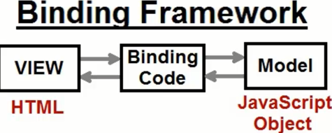
Angular
Angular – a Binding Framework
Angularjs.org – Angular 1
Angular.io - Angular 2

Slide 14
Angular
MVC Model
The Model-View-Controller (MVC) is an architectural pattern that separates an application into three main logical components: the model, the view, and the controller. Each of these components are built to handle specific development aspects of an application.
Model
The Model component corresponds to all the data-related logic that the user works with. This can represent either the data that is being transferred between the View and Controller components or any other business logic-related data.
For example, a Customer object will retrieve the customer information
from the database, manipulate it and update it data back to the database
or use it to render data.

Slide 15
Angular
MVW Model
View
The View component is used for all the UI logic of the application. For example, the Customer view will include all the UI components such as text boxes, dropdowns, etc. that the final user interacts with.
Controller
Controllers act as an interface between Model and View components to process all the business logic and incoming requests, manipulate data using the Model component and interact with the Views to render the final output. For example, the Customer controller will handle all the interactions and inputs from the Customer View and update the database using the Customer Model. The same controller will be used to view the Customer data.

Slide 16
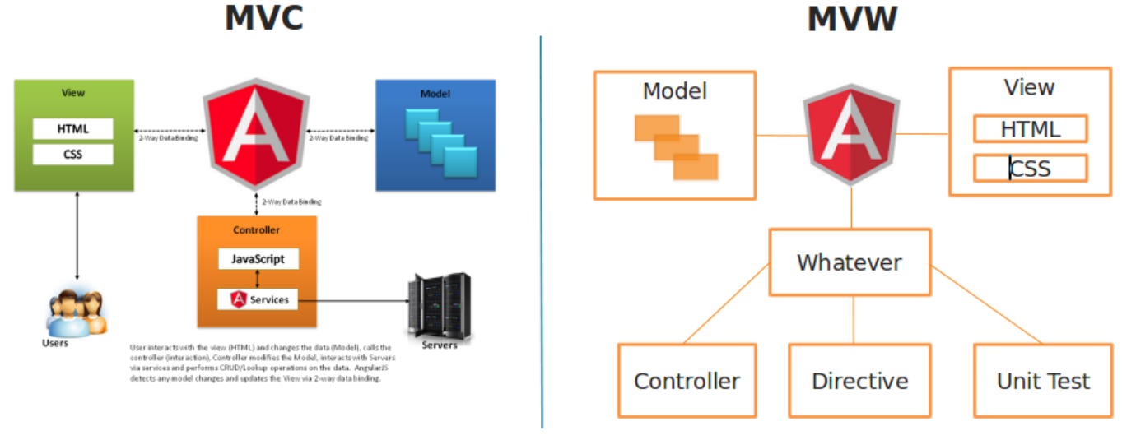
Angular
MVW Model

Slide 17
Angular
MVW Model
View
The View component is used for all the UI logic of the application. For example, the Customer view will include all the UI components such as text boxes, dropdowns, etc. that the final user interacts with.
Controller
Controllers act as an interface between Model and View components to process all the business logic and incoming requests, manipulate data using the Model component and interact with the Views to render the final output. For example, the Customer controller will handle all the interactions and inputs from the Customer View and update the database using the Customer Model. The same controller will be used to view the Customer data.

Slide 18
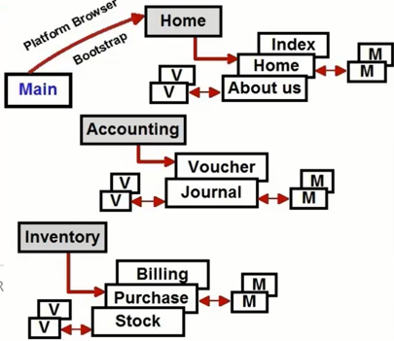
Angular
SRC Folder structure
Understanding the SRC folder structure
Components
Modules
View
Model
Main.ts
Index.html
Polyfills.js
Vendor.js and runtime.js
Going Live with webpack

Slide 19
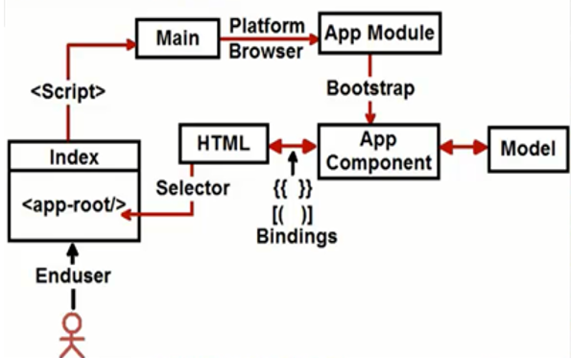
Angular
Flow of App running
Flow of Execution

Slide 20
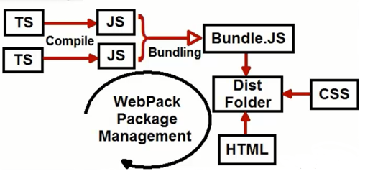
Angular
Going live with webpack
Going Live with WebPack

Slide 21
Angular
Going live with webpack
Runtime.js – This is for webpack runtime
Polyfill.js – helps to run new ES version JS in old browser
Vendor.js – This is the actual project code which you coded(Component, Modules, Model)
Main.js – This points to the first module of your project
Styles.js – All CSS code goes in this

Slide 22
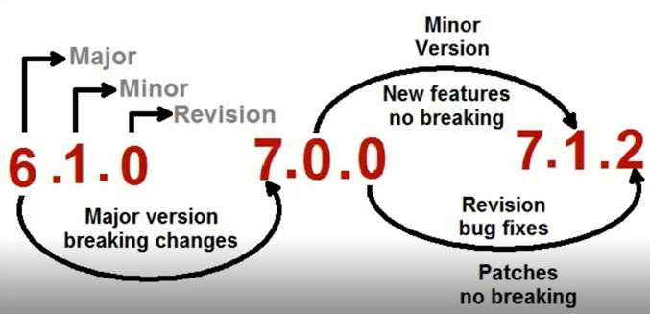
Angular
Major, Minor, Revision versions

Slide 23
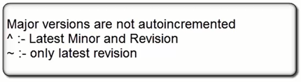
Angular
Major, Minor, Revision versions
npm view jquery versions
Update the package.json file with ^ or ~
Npm install will automatically install minor release or revision versions

Slide 24
THANK YOU
Aruna S
Department of
Computer Science and Engineering
arunas@pes.edu

